Slide 1
Islamic Microfinance
Challenges and Misconceptions
Vehbi Zeqiri
Executive Director | START Microfinance Institution | Republic of Kosovo
Photo by: Vehbi Zeqiri
Bardhosh, Kosovo

Slide 2
Experience/ Practitioners
Photo by: Vehbi Zeqiri
2/15
Durham, UK

Slide 3
Maintaining Balances
Donors/ Funders
Clients/ Beneficiaries
IMFI
Staff/ Govt.
Photo by: Vehbi Zeqiri
3/15
New York, USA

Slide 4
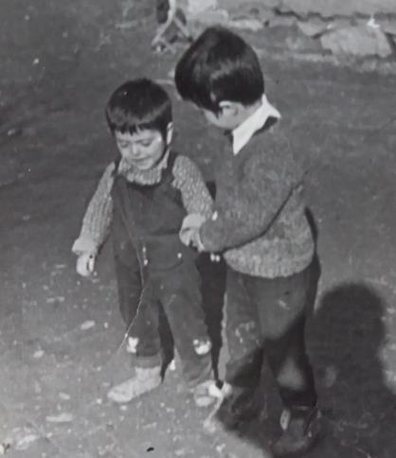
Microfinance Misconception
Loan Purpose?
Actual needs of the Beneficiaries?
Destitute vs. Active Poor?
Sustainability of MFI?
Targeted Beneficiaries!?
Poverty!?
4/15

Slide 5
Outreach vs. Sustainability
Candle vs. Led Lamp
Photo by: Vehbi Zeqiri
5/15
Vlora, Albania

Slide 6
6/15

Slide 7
PROFILE
Established in 2002 (16 Years)
Qard Hasan & Murabaha (Financial Products)
17,200 Clients – € 26.8 million
1st Islamic Financial Institution
Centre of Excellence
IDB main Funder
Portfolio - 3 million €
Photo by: Vehbi Zeqiri
7/15
Bardhosh, Kosovo

Slide 8
Social & Financial Performance
Professor Omneya Abdelsalam PhD
Professor Kamil Omoteso PhD
Dr Antonios Chantziaras
Photo by: Vehbi Zeqiri
8/15
Durham, UK
Strong institutional responsibility, especially towards clients and the community.
Low cost of borrowing and loans to people in need (e.g., widows, unemployed, low income earners, people in rural areas)
Lower cost of borrowing compared to other MFIs or Banks in the region

Slide 9
An Integrated Report is a concise communication about how an organization’s strategy, governance, performance and prospects lead to the creation of value over the short, medium and long term
http://integratedreporting.org/
9/15

Slide 10
1. Professor Omneya Abdelsalam PhD & 2. Professor Carol Adams PhD
http://integratedreporting.org/
10/15

Slide 11
Fin-Tech
Islamic Microfinance
Manage Complex Activities
Reg-Tech
Governance; Risk; Compliance
Photo by: Vehbi Zeqiri
11/15
Shengjin, Albania

Slide 12
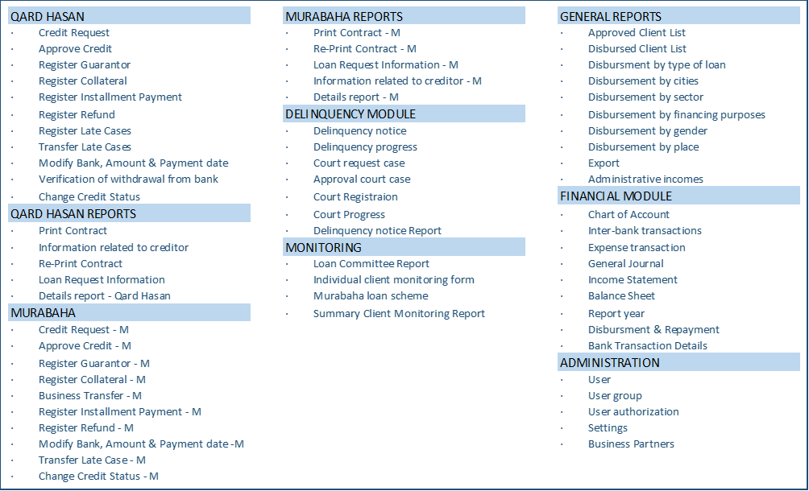
Software Modules/Components
12/15

Slide 13
Future Plans
START Academy
Maintain ‘Social Enterprise’ Model
New Financing Techniques
Invest in FinTech
Photo by: Vehbi Zeqiri
13/15
Colorado, USA

Slide 14
Challenges
Islamic Finance Awareness
Social Justice - Lack of Opportunity
Self-Sustainability/ Funding?
Huge Demand for Social Finance
Photo by: Vehbi Zeqiri
14/15
Istanbul, Turkey

Slide 15
Thank you
Vehbi Zeqiri
Photo by: Vehbi Zeqiri
Boge, Kosovo

